Slide 1
Statistics in Machine Learning
By
Sagar Latake
(Data Scientist)

Slide 2
Index
Population
Sample
Mean
Sample Mean
Random Variable
Discrete Random Variable
Continuous Random Variable
Gaussian Distribution / Normal Distribution
Log Normal Distribution
Why to Study Distribution
Covariance
Variance
Mean, Median and Mode
Central Limit Theorum
Pearson Correlation Coefficient

Slide 3
Statistics
Statistics is the discipline that concerns the collection, organization, analysis, interpretation, and presentation of data.
Example
Number of followers of a cricketer in India

Slide 4
Population
Population is the entire set of items from which you draw data for a statistical study. It can be a group of individuals, a set of items, etc. It makes up the data pool for a study.
Generally, population refers to the people who live in a particular area at a specific time. But in statistics, population refers to data on your study of interest. It can be a group of individuals, objects, events, organizations, etc.

Slide 5
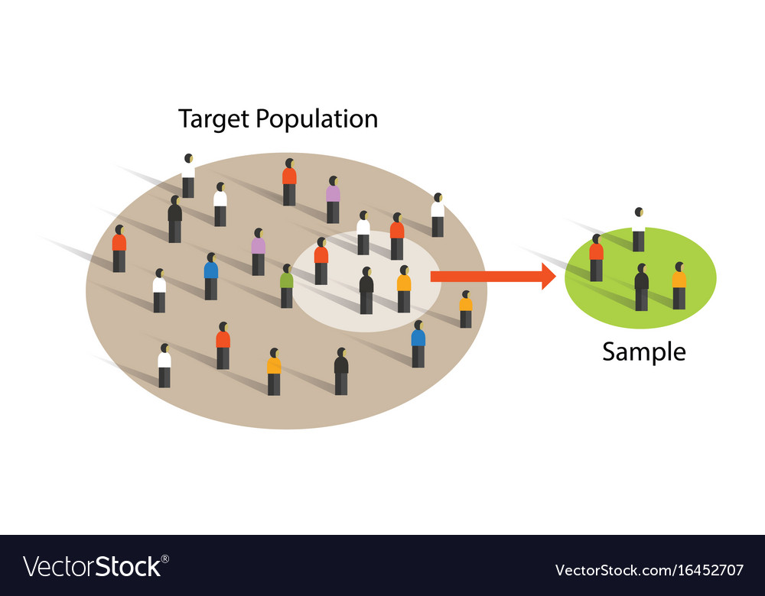

Slide 6
Sample
A sample represents the group of interest from the population, which you will use to represent the data. The sample is an unbiased subset of the population that best represents the whole data.

Slide 7
Mean
The population mean is an average of a group characteristic. The group could be a person, item, or thing
μ = (ΣX )/ N

Slide 8
Sample Mean
The sample mean is an average value found in a sample.
x̄ = ( Σ x_{i} ) / n
The sample mean is useful because it allows you to estimate what the whole population is doing

Slide 9
Random Variable
A random variable is a variable whose value is unknown or a function that assigns values to each of an experiment's outcomes.
Random variables are often designated by letters and can be classified as
discrete, which are variables that have specific values.
ex. Account Number, Aadhar Number
continuous, which are variables that can have any values within a continuous range.
ex. Salary, Heaight of person.

Slide 10
Gaussian Distribution
The normal distribution, also known as the Gaussian distribution, is the most important probability distribution in statistics for independent, random variables. Most people recognize its familiar bell-shaped curve in statistical reports.
The normal distribution is a continuous probability distribution that is symmetrical around its mean

Slide 11
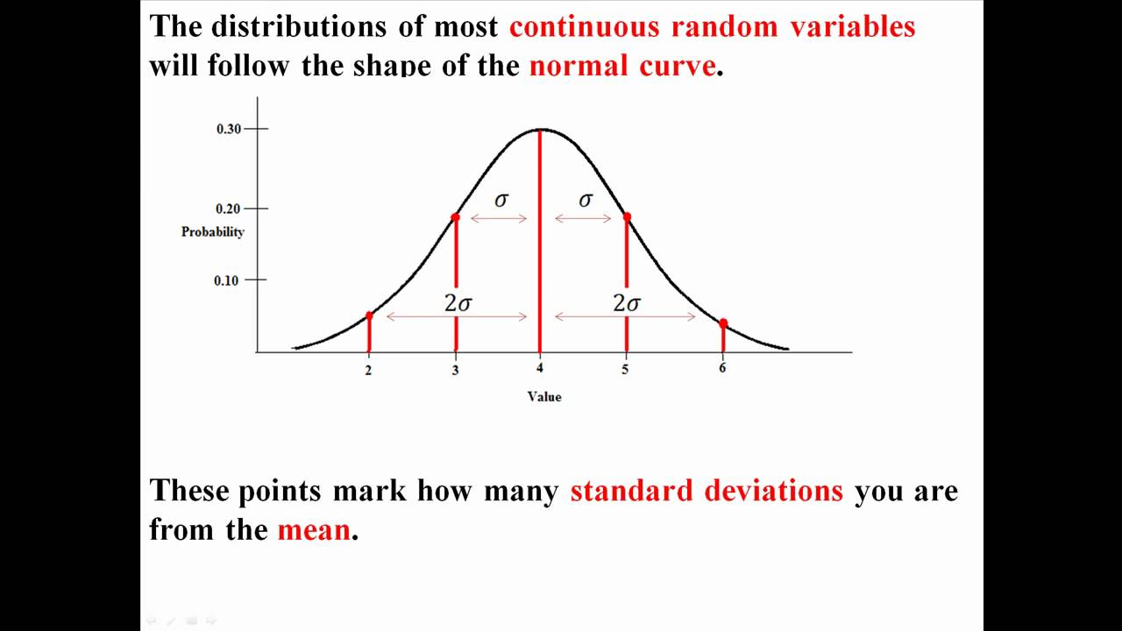

Slide 12
Empirical rule
The empirical rule predicts that 68% of observations falls within the first standard deviation (µ ± σ),
95% within the first two standard deviations (µ ± 2σ),
and 99.7% within the first three standard deviations (µ ± 3σ).

Slide 13
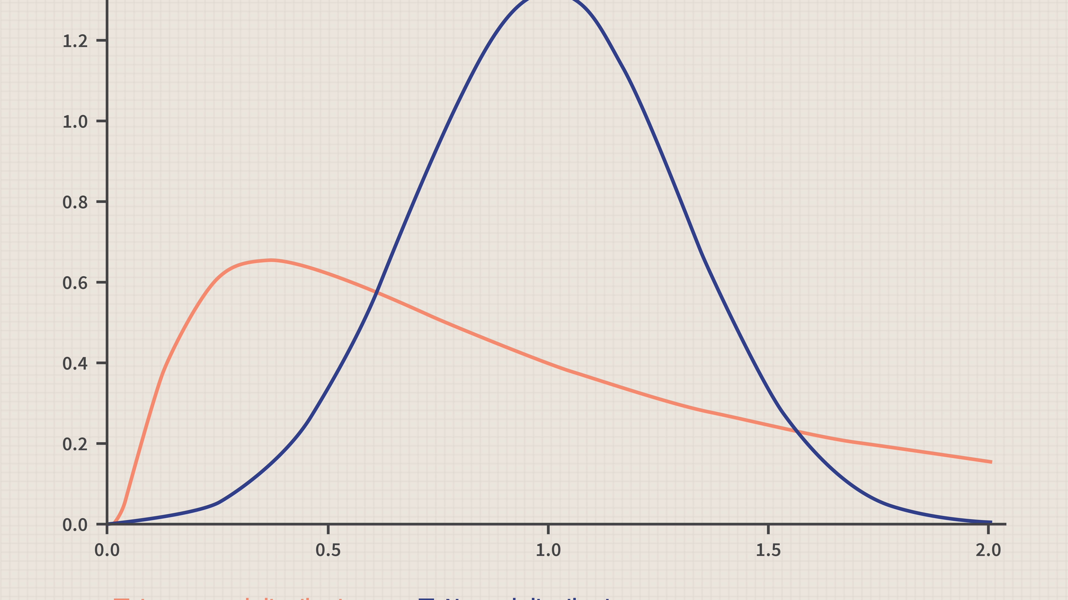

Slide 14
Log Normal Distribution
A log-normal distribution is a continuous distribution of random variable y whose natural logarithm is normally distributed.
For example, if random variable y=exp{y} has log-normal distribution
then x=log(y) has normal distribution.
Log-normal distributions are most often used in finance to model stock prices

Slide 15
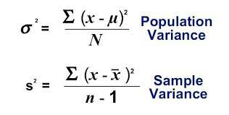
Variance
variance measures variability from the average or mean. It is calculated by taking the differences between each number in the data set and the mean

Slide 16
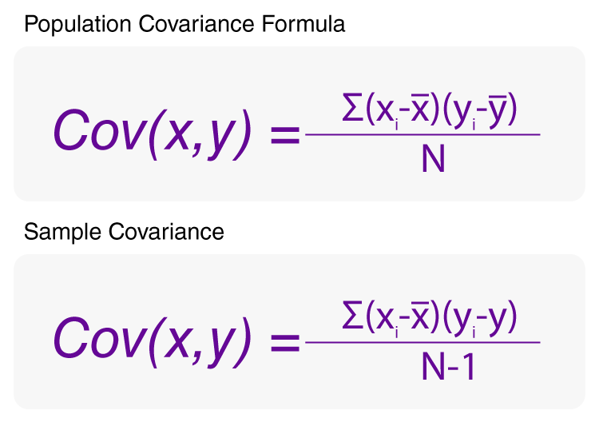
Covariance
covariance is a measure of the joint variability of two random variables

Slide 17
Mean , Median and Mode
mean, median, and mode, in mathematics, the three principal ways of designating the average value of a list of numbers.
The arithmetic mean is found by adding the numbers and dividing the sum by the number of numbers in the list. This is what is most often meant by an average.
The median is the middle value in a list ordered from smallest to largest.
The mode is the most frequently occurring value on the list.

Slide 18
Central Limit Theorem
CLT is a statistical premise that, given a sufficiently large sample size from a population with a finite level of variance, the mean of all sampled variables from the same population will be approximately equal to the mean of the whole population. Furthermore, these samples approximate a normal distribution, with their variances being approximately equal to the variance of the population

Slide 19
Central Limit Theorem
The central limit theorem (CLT) states that the distribution of sample means approximates a normal distribution as the sample size gets larger, regardless of the population's distribution.
Sample sizes equal to or greater than 30 are often considered sufficient for the CLT to hold.
A key aspect of CLT is that the average of the sample means and standard deviations will equal the population mean and standard deviation.
A sufficiently large sample size can predict the characteristics of a population more accurately.

Slide 20
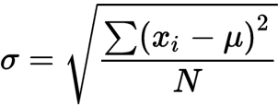
Standard Deviation
The standard deviation is a statistic that measures the dispersion of a dataset relative to its mean and is calculated as the square root of the variance.

Slide 21
Standard deviation measures the dispersion of a dataset relative to its mean.
It is calculated as the square root of the variance.
Standard deviation, in finance, is often used as a measure of a relative riskiness of an asset.
A volatile stock has a high standard deviation, while the deviation of a stable blue-chip stock is usually rather low.

Slide 22
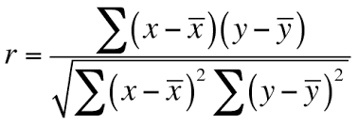
Correlation coefficients are used to measure how strong a relationship is between two variables.
There are several types of correlation coefficient, but the most popular is Pearson’s. Pearson’s correlation

Slide 23
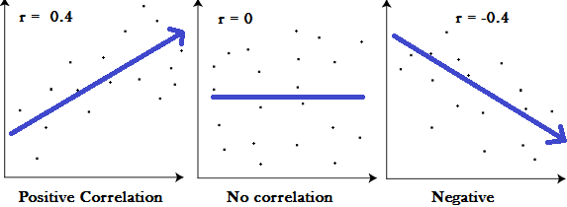
Pearson Correlation Coefficient

Slide 24
Skewness
skewness is the measure of how much the probability distribution of a random variable deviates from the normal distribution.
Positively Skewed Distribution
A positively skewed distribution is the distribution with the tail on its right side. The value of skewness for a positively skewed distribution is greater than zero
Negatively Skewed Distribution
negatively skewed distribution is the distribution with the tail on its left side. The value of skewness for a negatively skewed distribution is less than zero.

Slide 25
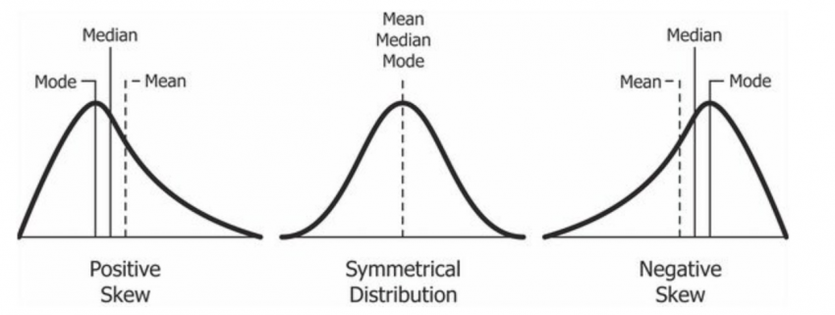

Slide 26
Bernoulli Distribution
A Bernoulli distribution is a discrete probability distribution for a Bernoulli trial — a random experiment that has only two outcomes (usually called a “Success” or a “Failure”).
For example, the probability of getting a heads (a “success”) while flipping a coin is 0.5. The probability of “failure” is 1 – P (1 minus the probability of success, which also equals 0.5 for a coin toss). It is a special case of the binomial distribution for n = 1. In other words, it is a binomial distribution with a single trial (e.g. a single coin toss).

Slide 27


Slide 28
5 Number summary
A five-number summary is especially useful in descriptive analyses or during the preliminary investigation of a large data set.
A summary consists of five values: the most extreme values in the data set (the maximum and minimum values), the lower and upper quartiles, and the median.
These values are presented together and ordered from lowest to highest: minimum value, lower quartile (Q1), median value (Q2), upper quartile (Q3), maximum value.

Slide 29
Sampling Technique
Sampling is a technique of selecting individual members or a subset of the population to make statistical inferences from them and estimate characteristics of the whole population.
Different sampling methods are widely used by researchers in market research so that they do not need to research the entire population to collect actionable insights.

Slide 30
Sampling Technique
For example, if a drug manufacturer would like to research the adverse side effects of a drug on the country’s population, it is almost impossible to conduct a research study that involves everyone. In this case, the researcher decides a sample of people from each demographic and then researches them, giving him/her indicative feedback on the drug’s behavior.

Slide 31
Types of sampling: sampling methods
two types –
probability sampling and
non-probability sampling.

Slide 32
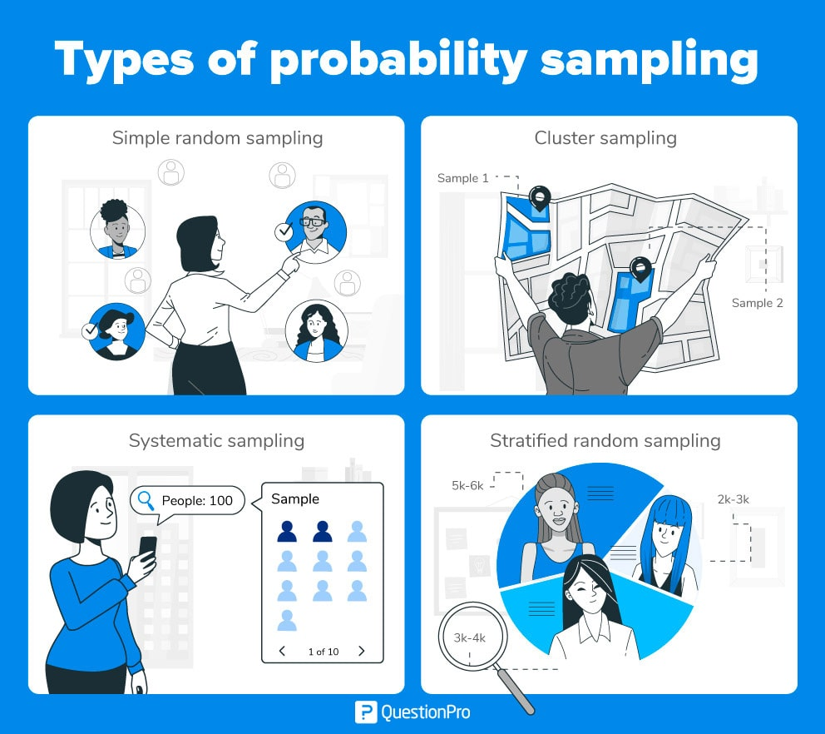
There are four types of probability sampling techniques:

Slide 33
Simple random sampling:
One of the best probability sampling techniques that helps in saving time and resources, is the Simple Random Sampling method. It is a reliable method of obtaining information where every single member of a population is chosen randomly, merely by chance

Slide 34
Cluster sampling:
Cluster sampling is a method where the researchers divide the entire population into sections or clusters that represent a population. Clusters are identified and included in a sample based on demographic parameters like age, sex, location, etc. This makes it very simple for a survey creator to derive effective inference from the feedback.

Slide 35
Systematic sampling:
Researchers use the systematic sampling method to choose the sample members of a population at regular intervals. It requires the selection of a starting point for the sample and sample size that can be repeated at regular intervals. This type of sampling method has a predefined range, and hence this sampling technique is the least time-consuming.

Slide 36
Stratified random sampling:
Stratified random sampling is a method in which the researcher divides the population into smaller groups that don’t overlap but represent the entire population. While sampling, these groups can be organized and then draw a sample from each group separately.

